Slide 1

Sarah Carotenuto & Cody Will
Effectiveness of Rattlesnake Aversion Training in Dogs
Consultation: October 10th, 2024
STAT688 | Huashi Li, Alex Salce, Taryn Laird

Slide 2
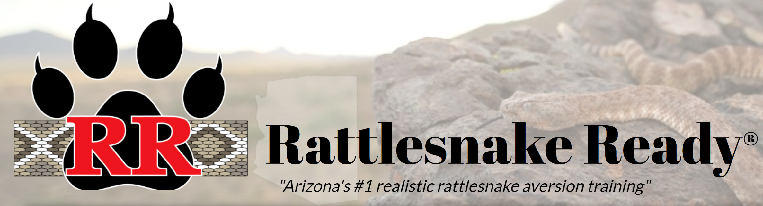
Effectiveness of Rattlesnake Aversion Training in Dogs
Client: Sarah Carotenuto
DVM, DABVP (CF), College of Veterinary Medicine
Cody Will, Rattlesnake Ready, LLC - Trainer
Summary of the Problem
Sarah is working with Cody Will, founder and trainer at Rattlesnake Ready, a Rattlesnake aversion/avoidance training service for Dogs
Rattlesnake envenomation in Dogs is very costly/traumatic, and they are interested in the effectiveness of training
Currently there is no published literature or data for the effectiveness of Rattlesnake training
Multiple methods/approaches to this training exist
They are interested in envenomation outcomes for dogs that have had encounters with snakes since training
Next Steps
Seeking input for data collection approach, survey questions, and other advice for how to help gather interpretable data
Sarah and Cody approached Statisticians before they attempted to collect any data!

Slide 3
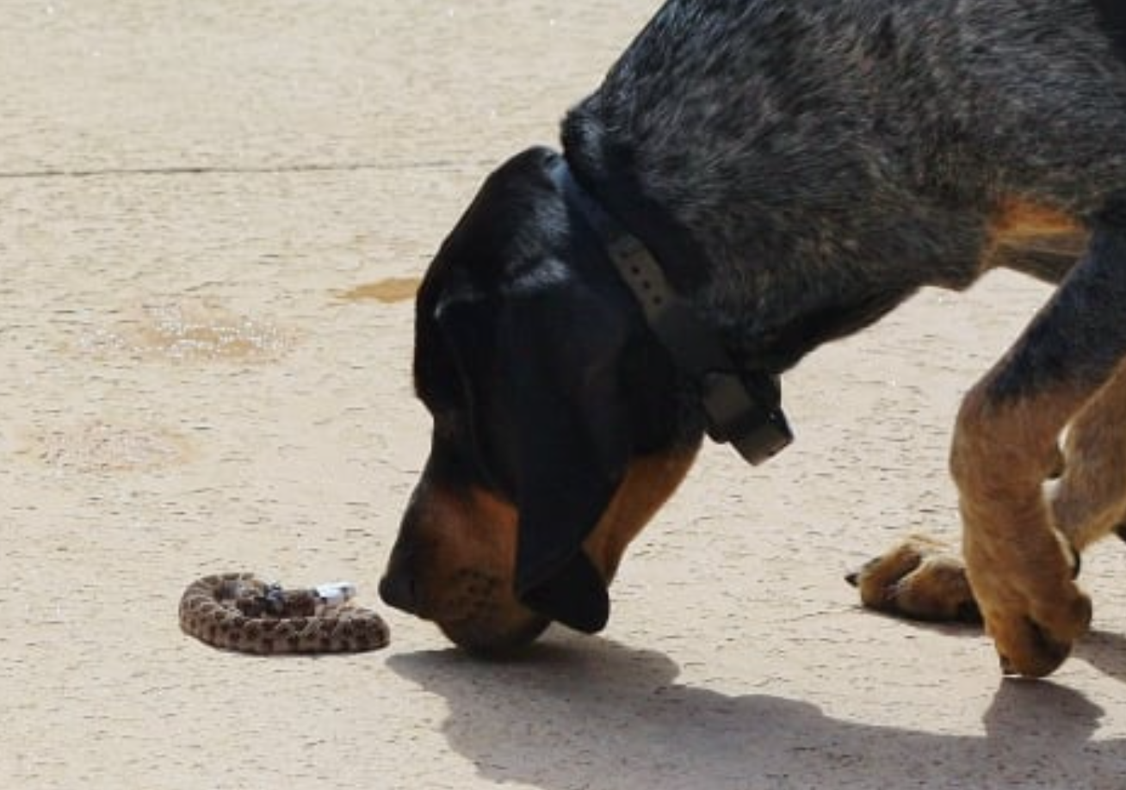
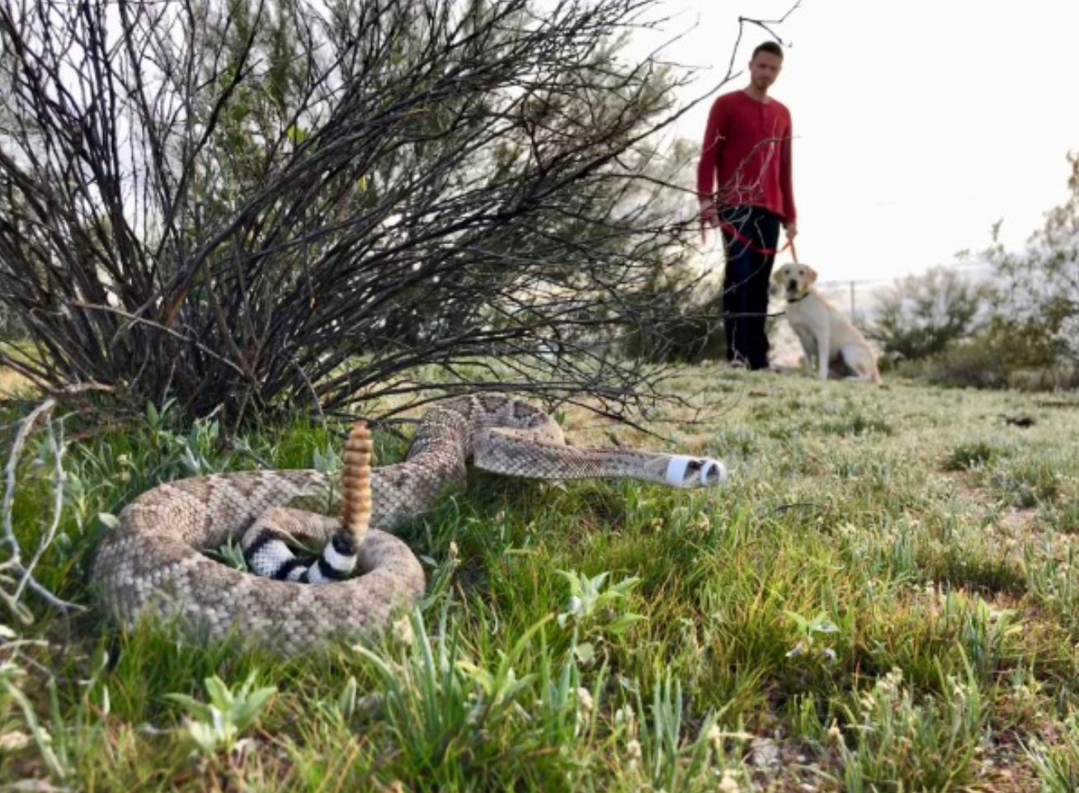
Survey Questions
Since training, has your dog encountered a rattlesnake? Yes/no
If yes- briefly describe the encounter. (can use AI to look for key words)
If yes- did your dog avoid the rattlesnake as trained? Yes, no, could not tell
If yes- how did your dog identify the rattlesnake? (scent, sight, sound, combination, unknown)
If no- did you schedule further training sessions for your dog?
If no, on a scale of 1-5 how confident do you feel that your dog would avoid a rattlesnake after training? (1=not confident, 5 = very confident)
Since training, has your dog been envenomated by a rattlesnake?
If yes, was the bite accidental, provoked, or unknown?
If yes, what was the approximate cost of treatment?
Additional (potential) questions:
What led you to seek rattlesnake aversion training for your dog?
Hiking
Hunting
Other outdoor activities
Live next to a wash/area known to have rattlesnakes
General Safety
Fear about cost of treating an envenomation
During the first step of training, was your dog initially interested in the rattlesnake?
Additional Information
This will be a preliminary study limited only to Cody’s clients
Cody already has demographic data for all dogs that receive training
Cody has annual follow ups with some of the dogs, where he re-evaluates their behaviors with a muzzled live Rattlesnake

